Slide 1
Naive Bayes
Some images and notes were retrieved from Hapke et. al Natural Language Processing in Action (2019)

Slide 2
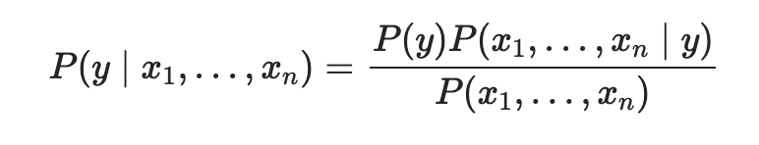
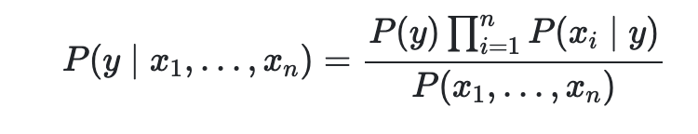
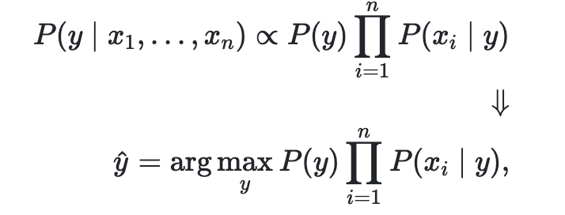
Naive Bayes
As Naive Bayes is a supervised learning algorithm which based on applying Bayes’ theorem with the "naive" assumption of conditional independence between every pair of features given the value of the class variable.
P(y | x₁,...,x_{n}) → posterior probability of class y given predictor X (x₁,...,x_{n})
P(y) → prior probability of class y
P(x₁,...,x_{n} | y) → likelihood which is the probability of predictor given class

Slide 3
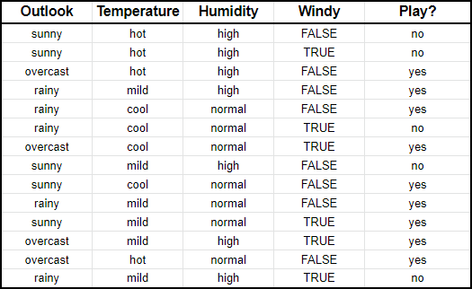
How Does It Work?
Imagine that X = {outlook: sunny, temperature: mild, humidity: normal,
windy: false}. We want to predict Play target with given features.

Slide 4


How Does It Work?
Recall that
P(X | y)
P(y)

Slide 5
How Does It Work?
Imagine that X = {outlook: sunny, temperature: mild, humidity: normal,
windy: false}. We want to predict Play target with given features.
P(Play: "yes") = 9/14
P(outlook: "sunny"| Play: "yes") = 2/9
P(temperature: "mild" | Play: "yes") = 4/9
P(humidity: "normal" | Play: "yes") = 6/9
P(windy: "false" | Play: "yes") = 6/9
P(Play: "yes" | X) = (9/14) * (2/9) * (4/9) * (6/9) * (6/9) = 0.0282
P(Play: "no") = 5/14
P(outlook: "sunny"| Play: "no") = 3/5
P(temperature: "mild" | Play: "no") = 2/5
P(humidity: "normal" | Play: "no") = 1/5
P(windy: "false" | Play: "no") = 2/5
P(Play: "no" | X) = (5/14) * (3/5) * (2/5) * (1/5) * (2/5) = 0.0068
Since P(Play: "yes" | X) > P(Play: "no" | X), we will predict the target as "yes".

Slide 6
Pros of Naive Bayes
It’s easy to understand the concept.
The training is so fast. When you have limited time for huge datasets, you may directly use it as a baseline.
When you satisfy the independence, then it generally performs better than logistic regression (especially for the multiclass prediction), and it needs less amount of training data.
It works well with categorical input variables. For numerical variable, normal distribution is assumed (bell curve, which is a strong assumption).

Slide 7
Cons of Naive Bayes
If we have a categorical variable (on test data) which does not exist in training data, then we cannot make a prediction. However, Laplace smoothing technique can be used for this problem.
The probability estimates are not the most trustworthy (probability outputs from predict_proba are not to be taken too seriously).
The algorithm has strong assumptions. In real life, it is almost impossible that we get a set of predictors which are completely independent.

Slide 8
Application of Naive Bayes
Real-time prediction: Since it’s so fast, it’s used for making predictions in real time.
Multiclass prediction: It’s a well known application for multi-class classification problems.
Text classification: Naive Bayes classifiers are generally used for text classification (ie. spam detection) due to the independence rule.

Slide 9
Type of Naive Bayes Algorithms
Multinomial Naive Bayes (MultinomialNB)
Gaussian Naive Bayes (GaussianNB)
Bernoulli Naive Bayes (BernoulliNB)
Categorical Naive Bayes (CategoricalNB)
Notes:
MultinomialNB: https://www.youtube.com/watch?v=O2L2Uv9pdDA
GaussianNB: https://www.youtube.com/watch?v=H3EjCKtlVog

Slide 10
Multinomial Naive Bayes
It implements the naive Bayes algorithm for multinomial distributed data, and is one of the two classic naive Bayes variants used in text classification
  where the data are typically represented as word vector counts
  although tf-idf vectors are also known to work well in practice
The distribution is parametrized by vectors θ_{y}=(θ_{y1,}θ_{y2,...,}θ_{yn}) for each class y where n is the number of features (in text classification, the size of the vocabulary) and θ_{yi} is the probability of P(x_{i}|y) of feature appearing in a sample belonging to class y.

Slide 11
Multinomial Naive Bayes
Assume that we want to compose a text classification model
  Normal → 8 documents → P(Normal) = 8/12 = 0.67 (Prior Probability)
    Dear → 8 times → P(Dear | Normal) = 8/17 = 0.47 (Likelihood)
    Friend → 5 times → P(Friend | Normal) = 5/17 = 0.29
    Lunch → 3 times → P(Lunch | Normal) = 3/17 = 0.18
    Money → 1 time → P(Money | Normal) = 1/17 = 0.06
  Spam → 4 documents → P(Spam) = 4/12 = 0.33
    Dear → 2 times → P(Dear | Spam) = 2/7 = 0.29
    Friend → 1 times → P(Friend | Spam) = 1/7 = 0.14
    Lunch → 0 times → P(Lunch | Spam) = 0/7 = 0
    Money → 4 times → P(Money | Spam) = 4/7 = 0.57

Slide 12
Multinomial Naive Bayes
  Normal → 8 documents → P(Normal) = 8/12 = 0.67 (Prior Probability)
    Dear → 8 times → P(Dear | Normal) = 8/17 = 0.47 (Likelihood)
    Friend → 5 times → P(Friend | Normal) = 5/17 = 0.29
    Lunch → 3 times → P(Lunch | Normal) = 3/17 = 0.18
    Money → 1 time → P(Money | Normal) = 1/17 = 0.06
  Spam → 4 documents → P(Normal) = 4/12 = 0.33
    Dear → 2 times → P(Dear | Spam) = 2/7 = 0.29
    Friend → 1 times → P(Friend | Spam) = 1/7 = 0.14
    Lunch → 0 times → P(Lunch | Spam) = 0/7 = 0
    Money → 4 times → P(Money | Spam) = 4/7 = 0.57
Let’s predict "Dear Friend"
  Normal → P(Normal) * P(Dear|Normal) * P(Friend|Normal)
  = 0.67 * 0.47 * 0.29 = 0.09
  Spam → P(Spam) * P(Dear|Spam) * P(Friend|Spam)
  = 0.33 * 0.29 * 0.14 = 0.01
  As a result, we predict as Normal.

Slide 13
Multinomial Naive Bayes
  Normal → 8 documents → P(Normal) = 8/12 = 0.67 (Prior Probability)
    Dear → 8 times → P(Dear | Normal) = 8/17 = 0.47 (Likelihood)
    Friend → 5 times → P(Friend | Normal) = 5/17 = 0.29
    Lunch → 3 times → P(Lunch | Normal) = 3/17 = 0.18
    Money → 1 time → P(Money | Normal) = 1/17 = 0.06
  Spam → 4 documents → P(Normal) = 4/12 = 0.33
    Dear → 2 times → P(Dear | Spam) = 2/7 = 0.29
    Friend → 1 times → P(Friend | Spam) = 1/7 = 0.14
    Lunch → 0 times → P(Lunch | Spam) = 0/7 = 0
    Money → 4 times → P(Money | Spam) = 4/7 = 0.57
Now, let’s predict "Lunch Money Money Money Money"
  Normal → P(Normal) * P(Lunch|Normal) * P(Money|Normal)⁴
  = 0.67 * 0.18 * 0.06⁴ = 0.000002
  Spam → P(Spam) * P(Lunch|Spam) * P(Money|Spam)⁴
  = 0.33 * 0 * 0.57⁴ = 0
  We have a problem with zero probabilities!

Slide 14
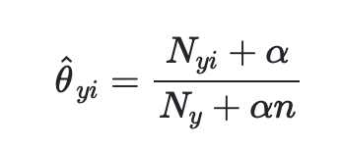
Multinomial Naive Bayes
In order to get rid of this problem, we apply smoothing techniques
The smoothing priors 𝜶 > 0 accounts for features not present in the learning samples and prevents zero probabilities.
  𝜶 = 1 → Laplace smoothing
  𝜶 < 1 → Lidstone smoothing

Slide 15
Multinomial Naive Bayes
  Normal → 8 documents → P(Normal) = 8/12 = 0.67 (Prior Probability)
    Dear → 8 times → P(Dear | Normal) = (8+1)/(17+4) = 0.43 (Likelihood)
    Friend → 5 times → P(Friend | Normal) = 6/21 = 0.29
    Lunch → 3 times → P(Lunch | Normal) = 4/21 = 0.19
    Money → 1 time → P(Money | Normal) = 2/21 = 0.10
  Spam → 4 documents → P(Normal) = 4/12 = 0.33
    Dear → 2 times → P(Dear | Spam) = 3/11 = 0.27
    Friend → 1 times → P(Friend | Spam) = 2/11 = 0.18
    Lunch → 0 times → P(Lunch | Spam) = 1/11 = 0.09
    Money → 4 times → P(Money | Spam) = 5/11 = 0.45
Now, let’s predict "Lunch Money Money Money Money"
  Normal → P(Normal) * P(Lunch|Normal) * P(Money|Normal)⁴
  = 0.67 * 0.19 * 0.1⁴ = 0.00001
  Spam → P(Spam) * P(Lunch|Spam) * P(Money|Spam)⁴
  = 0.33 * 0.09 * 0.45⁴ = 0.00112
  As a result, we predict as Spam.

Slide 16
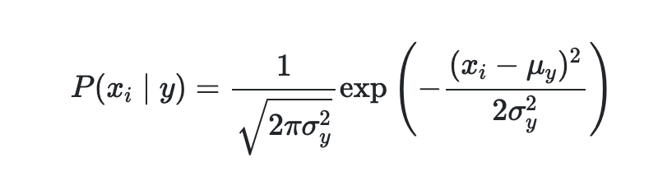
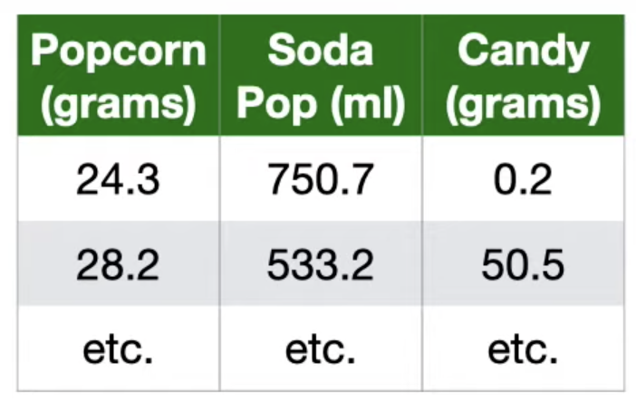
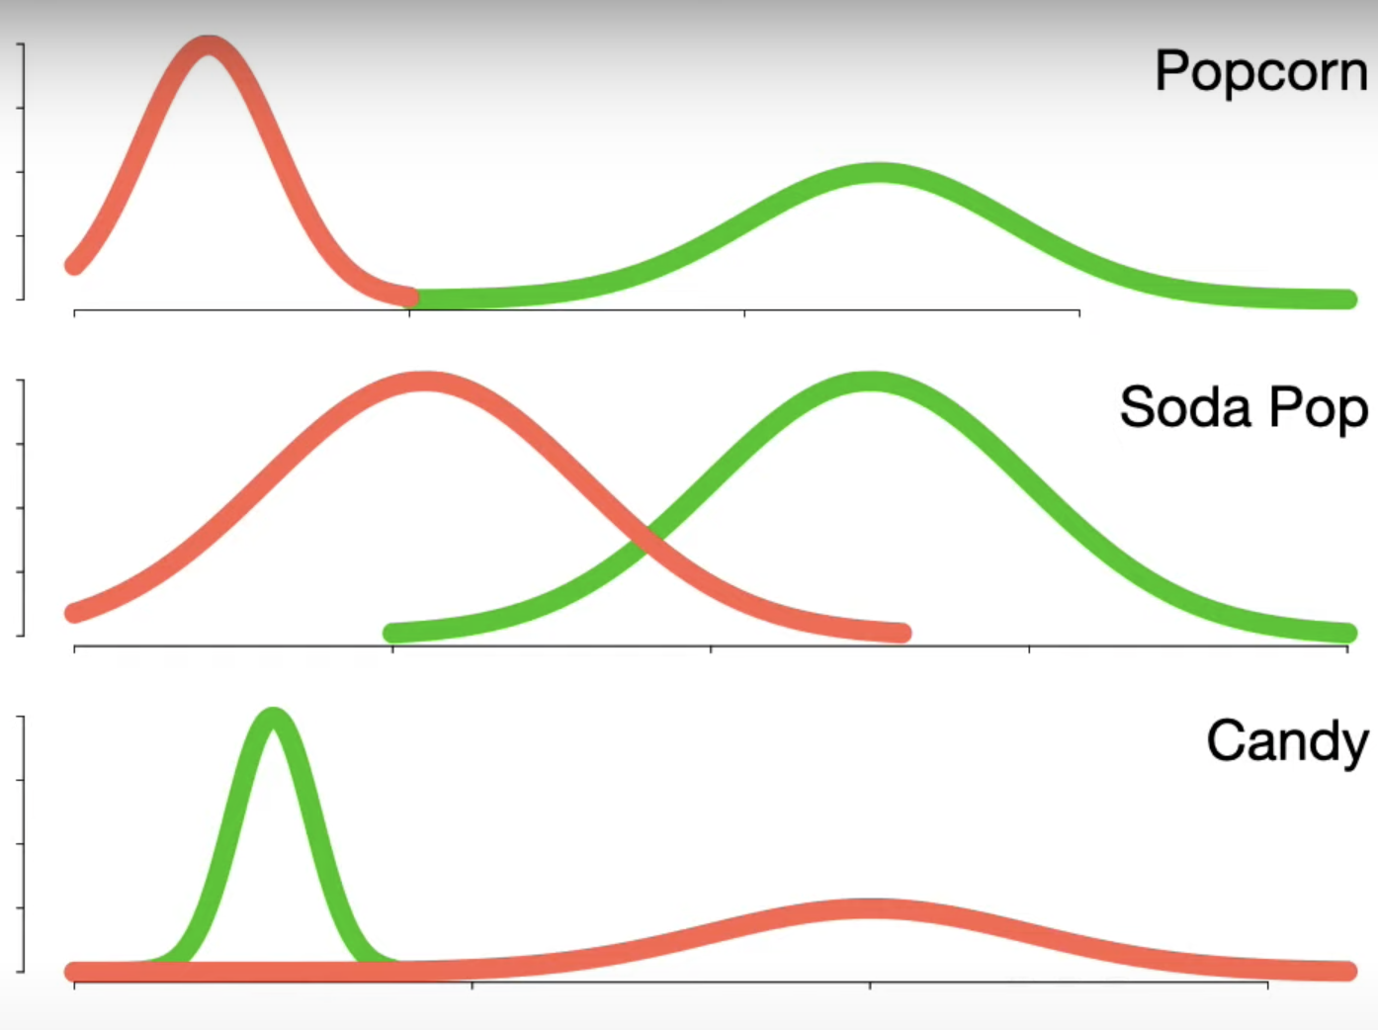
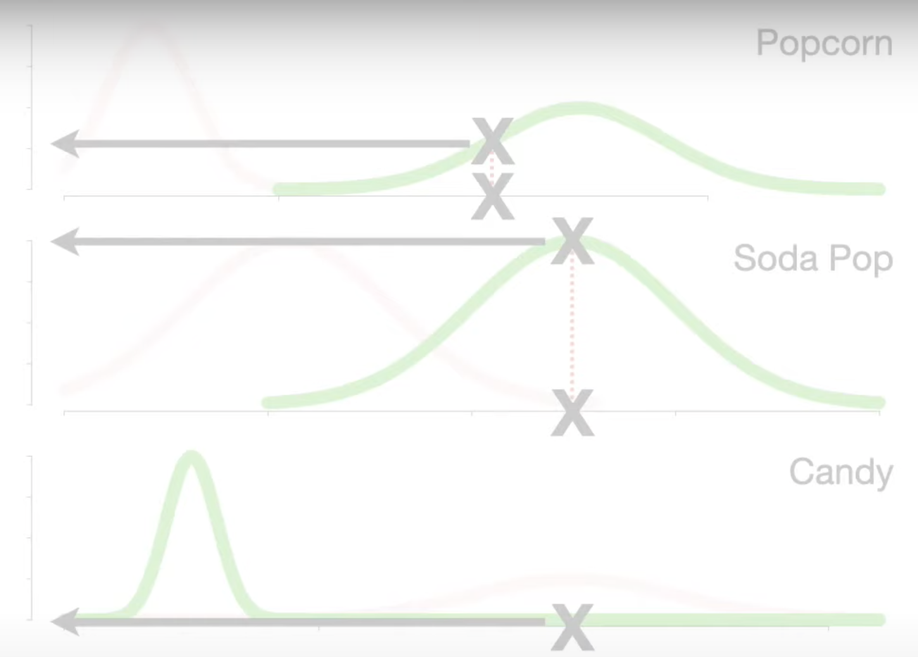
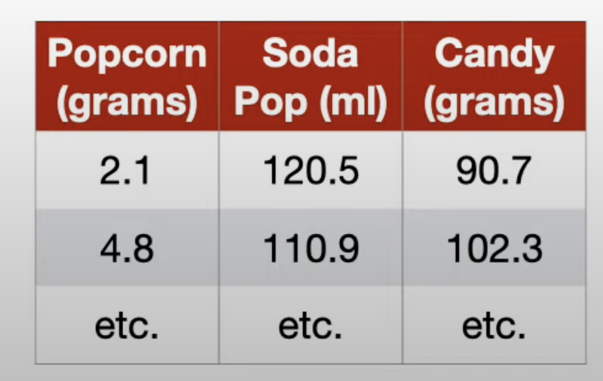
Gaussian Naive Bayes
It implements the Gaussian Naive Bayes algorithm for classification. The likelihood of the features is assumed to be Gaussian:
Let’s assume that we have two classes “Loving a movie”, “Not loving a movie”

Slide 17
Working with Text Documents
Text documents are unstructured (they have different words, number of words, lengths, etc).
We need to convert them into a structured format → called as vectorization.
  The aim is to represent the documents with numerical feature vectors.
  This specific strategy (tokenization, counting and normalization) is called the Bag of Words or “Bag of n-grams” representation.
    tokenizing strings and giving an integer id for each possible token, for instance by using white-spaces and punctuation as token separators.
    counting the occurrences of tokens in each document.
    normalizing and weighting with diminishing importance tokens that occur in the majority of samples / documents.
  Completely ignoring the relative position information of the words in the document
Another way is converting texts into structured format is using Word Embeddings.

Slide 18
Working with Text Documents
Sparsity is always an issue with text vectorization. The resulting matrix will have many feature values that are zeros (typically more than 99% of them).
For instance a collection of 10,000 short text documents (such as emails) will use
  a vocabulary with a size in the order of 100,000 unique words in total
  each document will use 100 to 1000 unique words individually.
Scikit-learn uses scipy.sparse package for efficiency reasons.

Slide 19
Working with Text Documents
from sklearn.feature_extraction.text import CountVectorizer
vectorizer = CountVectorizer(strip_accents="unicode")
corpus = [
'This is the first document. ustanbul üstanbul',
'This is the second second document.',
'And the third one.',
'Is this the first document?']
X = vectorizer.fit_transform(corpus)
X.toarray()
array([[0, 1, 1, 1, 0, 0, 1, 0, 1, 2],
[0, 1, 0, 1, 0, 2, 1, 0, 1, 0],
[1, 0, 0, 0, 1, 0, 1, 1, 0, 0],
[0, 1, 1, 1, 0, 0, 1, 0, 1, 0]])

Slide 20
Working with Text Documents
vectorizer.get_feature_names()
['and', 'document', 'first', 'is', 'one', 'second', 'the', 'third', 'this', 'ustanbul']
vectorizer.transform(['Something completely new.']).toarray()
array([[0, 0, 0, 0, 0, 0, 0, 0, 0, 0]])

Slide 21

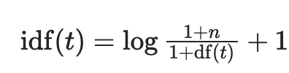
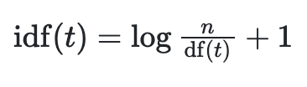

tf-idf Term Weighting
Some terms (tokens) in the corpus occur so frequently in many documents. In such cases, those very frequent terms would shadow the frequencies of rarer yet more interesting terms.
tf → term frequency
idf → inverse document frequency
where n is the total number of documents in the document set, and df(t) is the number of documents in the document set that contain term t (when smooth_idf=True).
When smooth_idf=False, the formula becomes like the following
The resulting tf-idf vectors are then normalized by the Euclidean norm

Slide 22
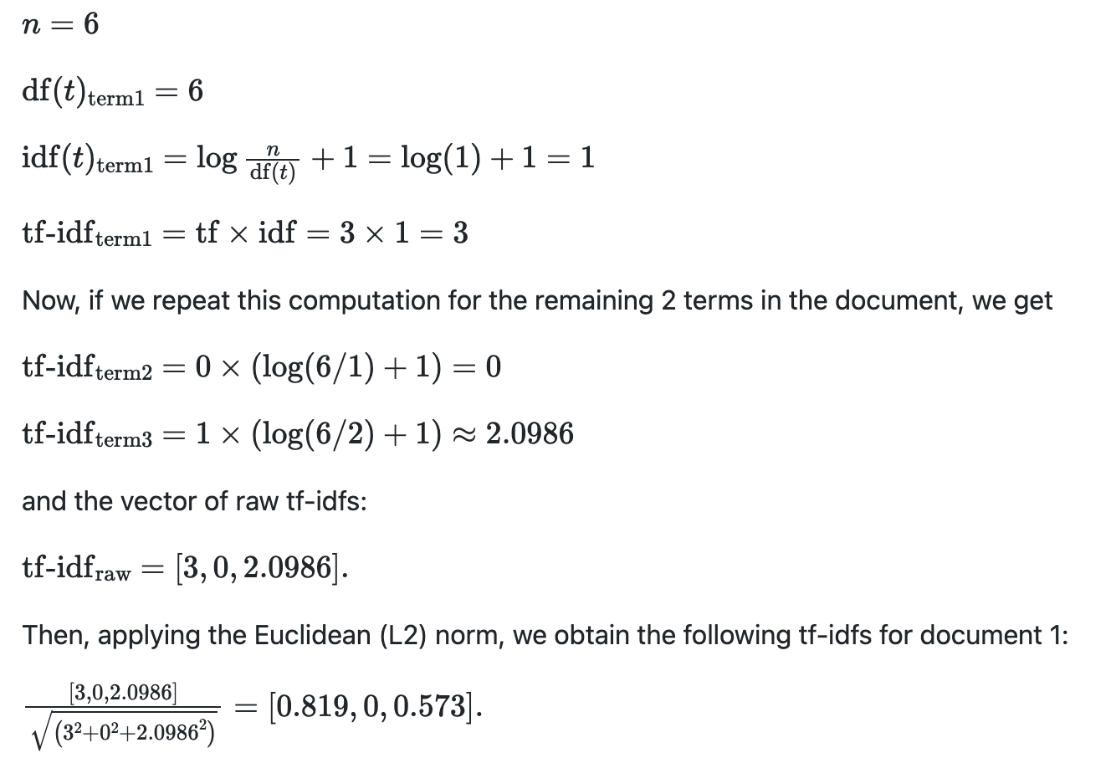
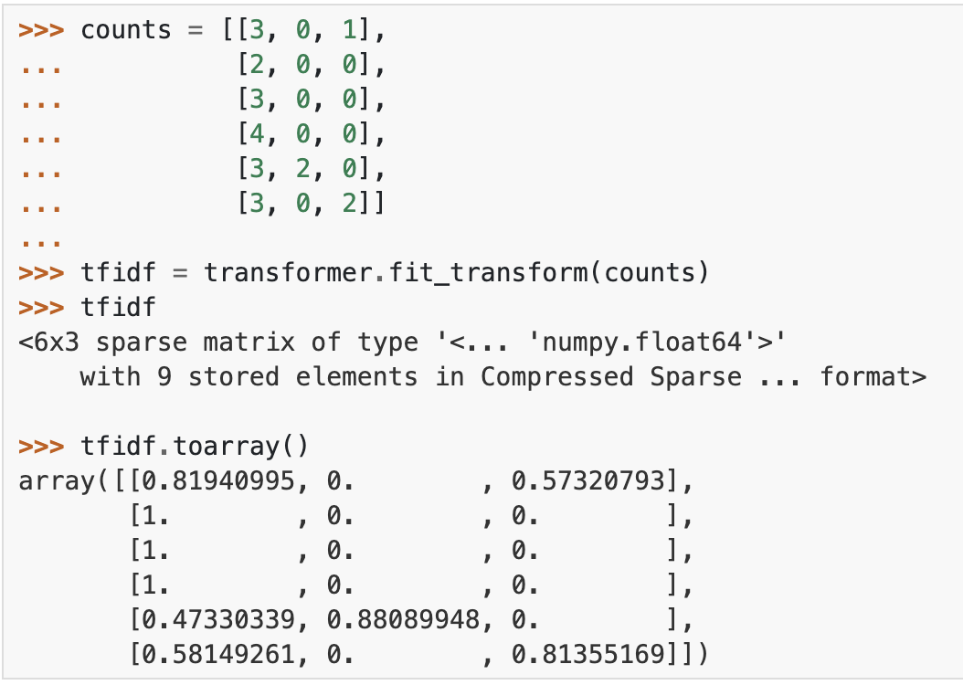
tf-idf Term Weighting (Example)
For example, we can compute the tf-idf of the first term in the first document in the counts array as follows:

Slide 23
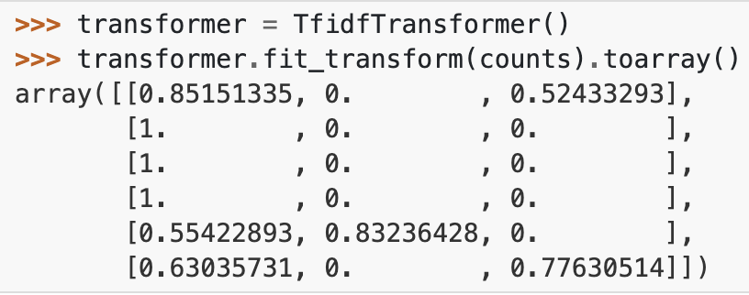
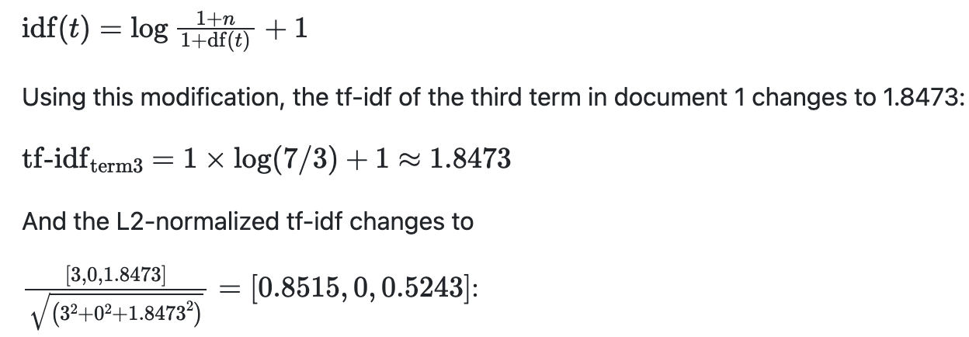
tf-idf Term Weighting (Example)
Furthermore, the default parameter smooth_idf=True adds "1" to the numerator and denominator to prevent zero divisions:

Slide 24
tf-idf Term Weighting
from sklearn.feature_extraction.text import CountVectorizer, TfidfTransformer
corpus = [
'This is the first document. ustanbul üstanbul',
'This is the second second document.',
'And the third one.',
'Is this the first document?']
vectorizer = CountVectorizer(strip_accents="unicode")
X = vectorizer.fit_transform(corpus)
transformer = TfidfTransformer(smooth_idf=False)
transformer.fit_transform(X).toarray()

Slide 25
tf-idf Term Weighting
from sklearn.feature_extraction.text import CountVectorizer, TfidfTransformer
from sklearn.pipeline import Pipeline
# or it's better to use pipeline
pipe = Pipeline([
("count_vec", CountVectorizer(strip_accents="unicode")),
("tfidf_vec", TfidfTransformer(smooth_idf=False))
])
pipe.fit_transform(corpus)

Slide 26
tf-idf Term Weighting
from sklearn.feature_extraction.text import TfidfVectorizer
# or we can directly use TfidfVectorizer
tf_vect = TfidfVectorizer(strip_accents="unicode", smooth_idf=False)
tf_vect.fit_transform(corpus)

Slide 27
Additional Notes
One may set binary=True of CountVectorizer, so all non zero counts are set to 1. Then BernoulliNB can be used for further classification.
CategoricalNB implements the categorical naive Bayes algorithm for categorically distributed data. It assumes that each feature, which is described by the index , has its own categorical distribution.
CategoricalNB assumes that the sample matrix X is encoded (for instance with the help of OrdinalEncoder) such that all categories for each feature i are represented with numbers 0,1,2,…,n_{i}-1 where n_{i} is the number of available categories of feature.

Slide 28
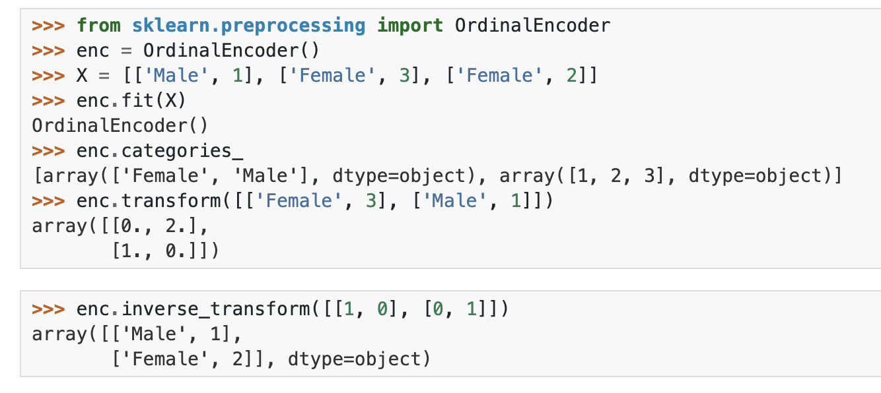
Ordinal Encoding
It encodes categorical features as an integer array.

Slide 29
Tokenization
Tokenization is a way of separating a piece of text into smaller units called tokens.
Tokenization can be applied to generate words or characters. We will mainly focus on words.
There are different tokenizers that we can utilize in our problems.
Scikit-learn uses a “regular expression tokenizer” (r”(?u)\b\w\w+\b”). The default regexp (regular expression) selects tokens of 2 or more alphanumeric characters (punctuation is completely ignored and always treated as a token separator).

Slide 30
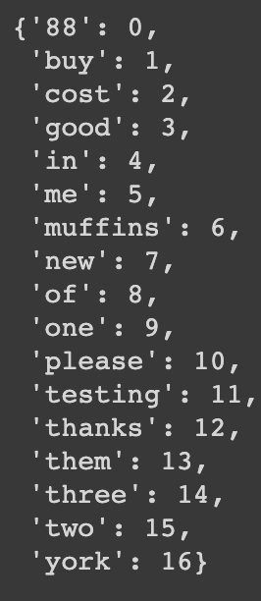
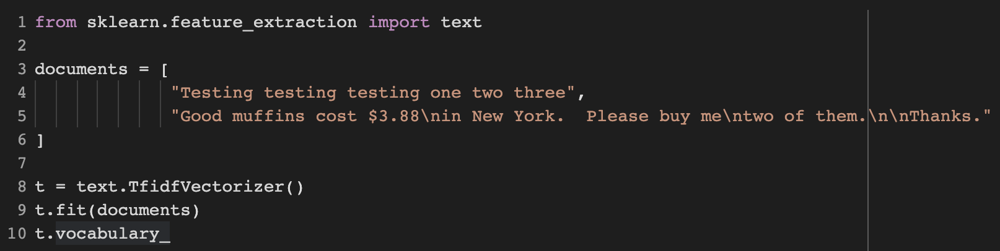
Sklearn Default Tokenizer
Remember the sklearn’s default tokenizer

Slide 31
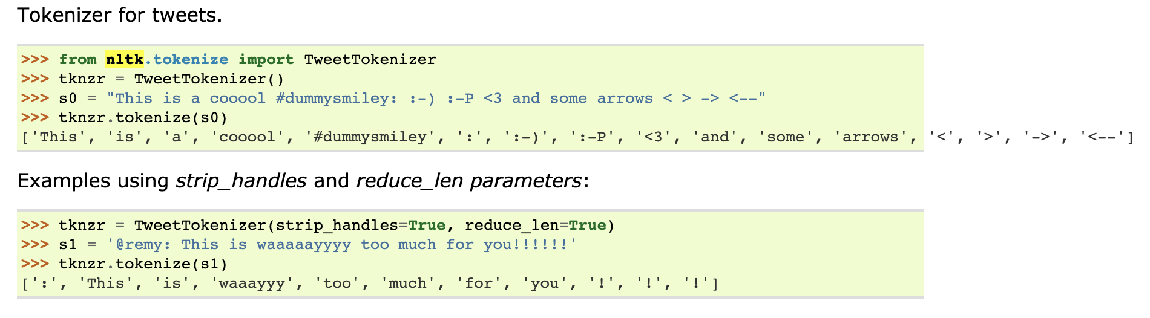
NLTK Tokenizers - Casual Mode
Twitter-aware tokenizer, designed to be flexible and easy to adapt to new domains and tasks.

Slide 32
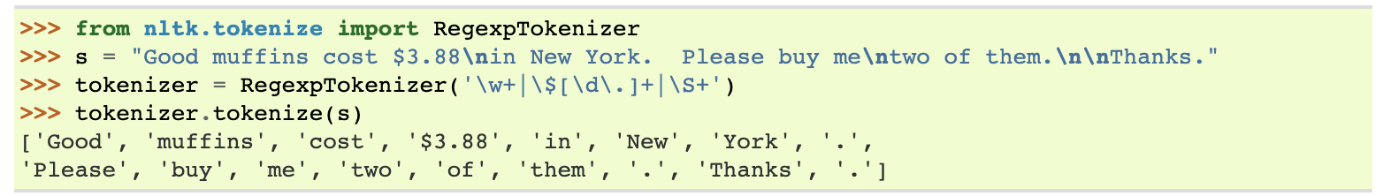
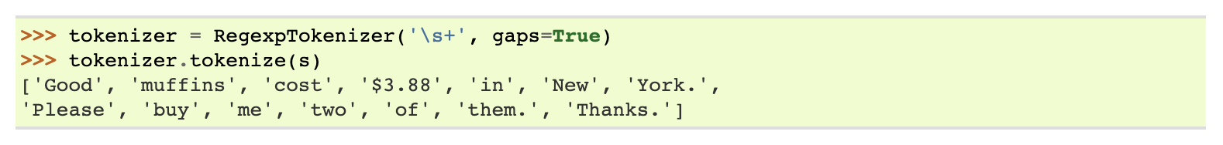
NLTK Tokenizers - regexp Module
A RegexpTokenizer splits a string into substrings using a regular expression.
For example, the following tokenizer forms tokens out of alphabetic sequences, money expressions, and any other non-whitespace sequences:
Another RegexpTokenizer can use its regexp to match delimiters instead (setting gap parameter as True):

Slide 33
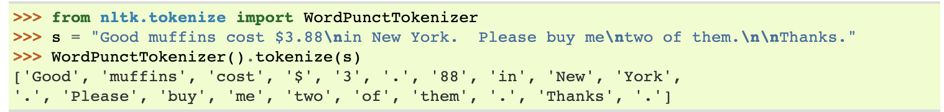
NLTK Tokenizers - WordPunctTokenizer
WordPunctTokenizer tokenizes a text into a sequence of alphabetic and non-alphabetic characters, using the regexp \w+|[^\w\s]+.
It can also be called as follows

Slide 34
NLTK Tokenizers - word_tokenize
word_tokenize on the other hand is based on a TreebankWordTokenizer.
WordPunctTokenizer will split pretty much at all special symbols and treat them as separate units. On the other hand, word_tokenize keeps things like 'm (from I'm) together. Here is an example:
>>> sent = "I'm a dog and it's great! You're cool and Sandy's book is big. Don't tell her, you'll regret it! 'Hey', she'll say!"
>>> word_tokenize(sent)
['I', "'m", 'a', 'dog', 'and', 'it', "'s", 'great', '!', 'You', "'re", 'cool', 'and', 'Sandy', "'s", 'book', 'is', 'big', '.', 'Do', "n't", 'tell', 'her', ',', 'you', "'ll", 'regret', 'it', '!', "'Hey", "'", ',', 'she', "'ll", 'say', '!']
>>> wordpunct_tokenize(sent)
['I', "'", 'm', 'a', 'dog', 'and', 'it', "'", 's', 'great', '!', 'You', "'", 're', 'cool', 'and', 'Sandy', "'", 's', 'book', 'is', 'big', '.', 'Don', "'", 't', 'tell', 'her', ',', 'you', "'", 'll', 'regret', 'it', '!', "'", 'Hey', "',", 'she', "'", 'll', 'say', '!']

Slide 35
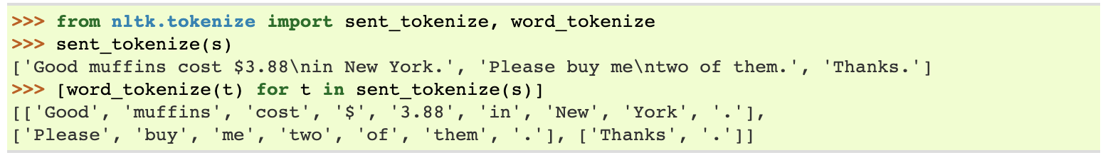
NLTK Tokenizers - sent_tokenize
It is used to separate sentences from a paragraph or a document (in case of needed).

Slide 36
Sklearn Default Tokenizer
Remember the sklearn’s default tokenizer

Slide 37
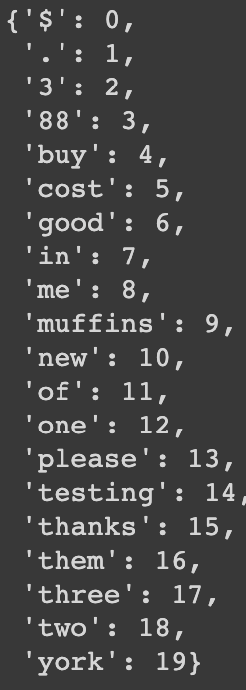
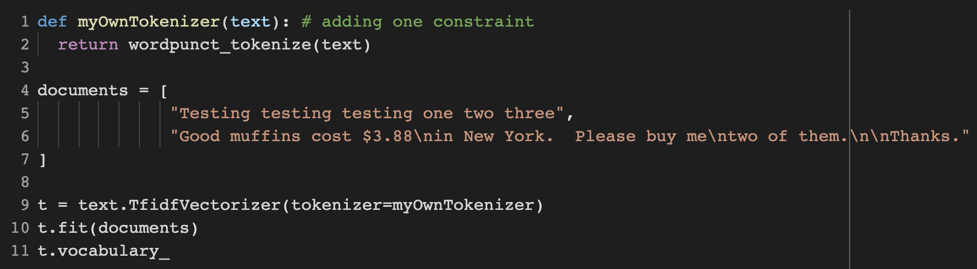
Using a Custom Tokenizer with Sklearn

Slide 38
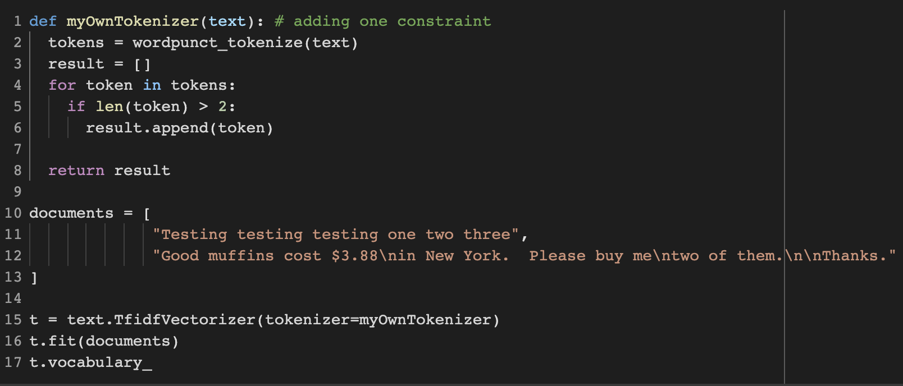
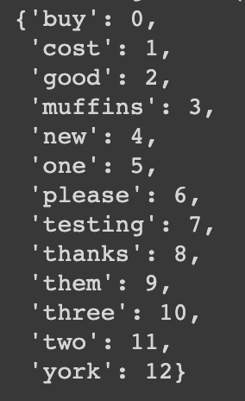
Using a Custom Tokenizer with Sklearn
Let’s filter short tokens whose length is smaller than 3.

Slide 39
Stop Words
Stop words are common words in any language that occur with a high frequency but carry much less substantive information about the meaning of a phrase.
Some examples: of, an, a, the, this, and, or
Generally, stop words are tend to be removed from the data. Even though the words themselves carry little information, the stop words can still provide important relational information as part of an n-gram. For example,
“Mark reported to the CEO”
“Suzanne reported as the CEO to the board”
“reported to the CEO” vs “reported as the CEO” are two different concepts that indicates the hierarchy. If we remove stop words, then we lose this information. However, we need to use n-grams to catch this information.

Slide 40
Stop Words
If you worry about the complexity of the model due to the huge dimension size, stop words will not increase the dimension that much.
A typical stop word list has only around 100 words. But a vocabulary size of 20,000 words would be required to keep track of 95% of the words seen in a large corpus of tweets, blogs, and news articles (source).
Therefore, removing stop words will not help you to speed up your algorithm and escaping from overfitting. Additionally, if you remove all the stop words, then you may lose a lot of information from 2-grams. For instance,
  “The Shining” (a horror movie)
  “Shining light”
  would be treated as same token.
Last but not least, different versions of nltk and sklearn have different stop words set, it may prevent you reproduce your results.

Slide 41
Vocabulary Normalization
There are 3 different types of vocabulary normalization:
  Case folding
  Stemming
  Lemmatization

Slide 42
Vocabulary Normalization - Case Folding
Case folding (also known as case normalization) is a super easy operation and the purpose is to normalize words into the same form in case (e.g. “The” and “the” will be treated as two different unigrams if no case-folding)
However, capitalization carries some information. For instance “Doctor” and “doctor” have different meanings. Again, “The Shining” (movie) and “shining light” has different shining tokens.
Often capitalization is used to indicate that a word is a proper noun, the name of a person, place, or thing.
On the other hand, if you do not normalize capital letters, then your vocabulary will be much bigger and may lead overfitting.

Slide 43
Vocabulary Normalization - Case Folding
One option would be to normalize only the first word of the sentence. This prevents “Joe” from being confused with “coffee” (“joe”) (surely, if “Joe” is not the first word of the sentence).
However, “Joe Smith, the word smith, with a cup of joe.” will have a different tokens than “Smith the word with a cup of joe, Joe Smith.”
For all of these reasons, many NLP applications do not use case normalization.
The best way is to try different approaches, and find the approach which gives the best result for your problem.

Slide 44
Vocabulary Normalization - Stemming & Lemmatization
Stemming just removes or stems the last few characters of a word, often leading to incorrect meanings and spelling.
Lemmatization considers the context and converts the word to its meaningful base form, which is called Lemma. Sometimes, the same word can have multiple different Lemmas. We should identify the Part of Speech (POS) tag for the word in that specific context.

Slide 45
Vocabulary Normalization - Stemming & Lemmatization
Here are the examples to illustrate all the differences and use cases:
  If you lemmatize the word 'Caring', it would return 'Care'. If you stem, it would return 'Car' and this is erroneous.
  If you lemmatize the word 'Stripes' in verb context, it would return 'Strip'. If you lemmatize it in noun context, it would return 'Stripe'. If you just stem it, it would just return 'Strip'.
  You would get same results whether you lemmatize or stem words such as walking, running, swimming... to walk, run, swim etc.
  Lemmatization is computationally expensive since it involves look-up tables and what not. If you have large dataset and performance is an issue, go with Stemming. Remember you can also add your own rules to Stemming. If accuracy is important and dataset isn't huge, go with Lemmatization. (Source)

Slide 46
Vocabulary Normalization - Stemming & Lemmatization
from nltk.stem import WordNetLemmatizer
from nltk import word_tokenize, wordpunct_tokenize, pos_tag
import nltk
from nltk.corpus import wordnet
nltk.download('wordnet')
nltk.download('averaged_perceptron_tagger')
nltk.pos_tag(["going"]) # outputs -> [('going', 'VBG')]

Slide 47
Vocabulary Normalization - Stemming & Lemmatization
def get_wordnet_pos(word):
"""Map POS tag to first character lemmatize() accepts"""
tag = nltk.pos_tag([word])[0][1][0].upper()
tag_dict = {"J": wordnet.ADJ,
"N": wordnet.NOUN,
"V": wordnet.VERB,
"R": wordnet.ADV}
return tag_dict.get(tag, wordnet.NOUN)
get_wordnet_pos("going") # returns -> 'v'
get_wordnet_pos("table") # returns -> 'n'

Slide 48
Vocabulary Normalization - Stemming & Lemmatization
def myOwnTokenizer(text):
lemmatizer = WordNetLemmatizer()
tokens = wordpunct_tokenize(text)
result = []
for token in tokens:
token = lemmatizer.lemmatize(token, get_wordnet_pos(token))
result.append(token)
return result

Slide 49
Vocabulary Normalization - Stemming & Lemmatization
documents = [
"Testing testing testing one two three",
"She is flying to New york, and it's surprising.",
"Good muffins cost $3.88\nin New York. Please buy me\ntwo of them.\n\nThanks."
]
t = text.TfidfVectorizer(tokenizer=myOwnTokenizer, stop_words="english")
t.fit(documents)
t.vocabulary_

Slide 50
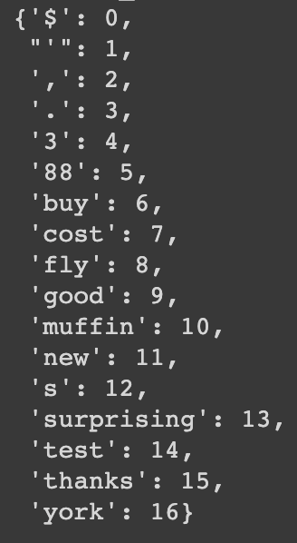
Vocabulary Normalization - Stemming & Lemmatization

